Slide 1
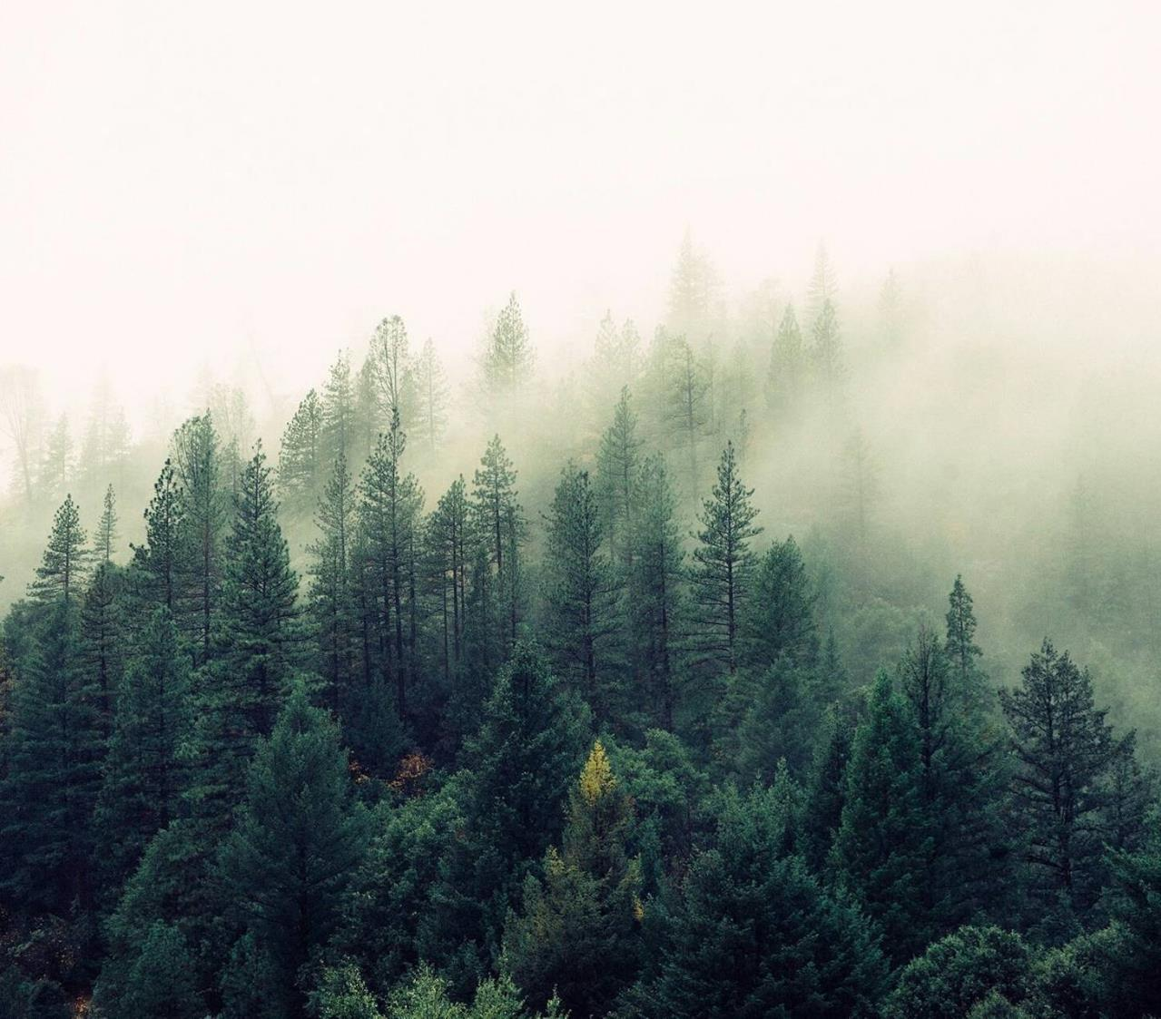
Household Plant Management System
Floraphile

Slide 2

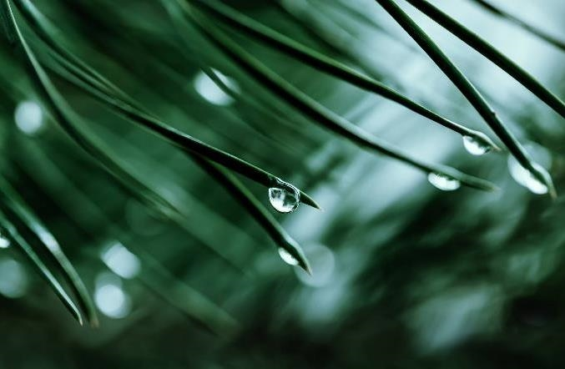

Floraphile
We are a Flutter based project, that makes use of an image classifier, to identify the plant species of household plants found in Indian homes. Our application helps the user take care of their plants and help add aesthetic value to their homes.

Slide 3
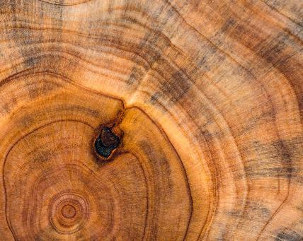
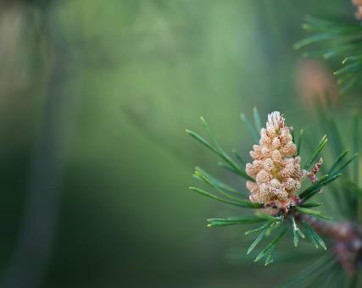
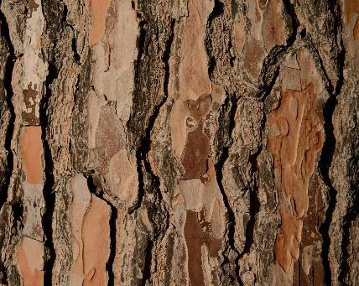

Agenda
Overview
Process Flow
Python Libraries Used
Limitations
Future Expansion

Slide 4

Overview

Slide 5
Features of our Application:
Simple Design
Abstraction of the Classifier Model
Easy to Understand
Easy to Use
Robust
Scalable
In house Image Classifier
Compatible with Android and iOS

Slide 6
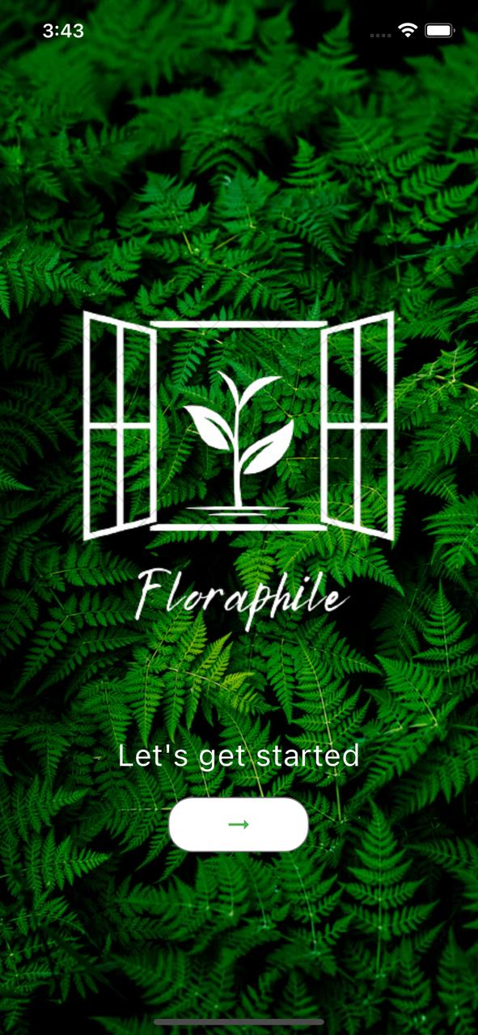
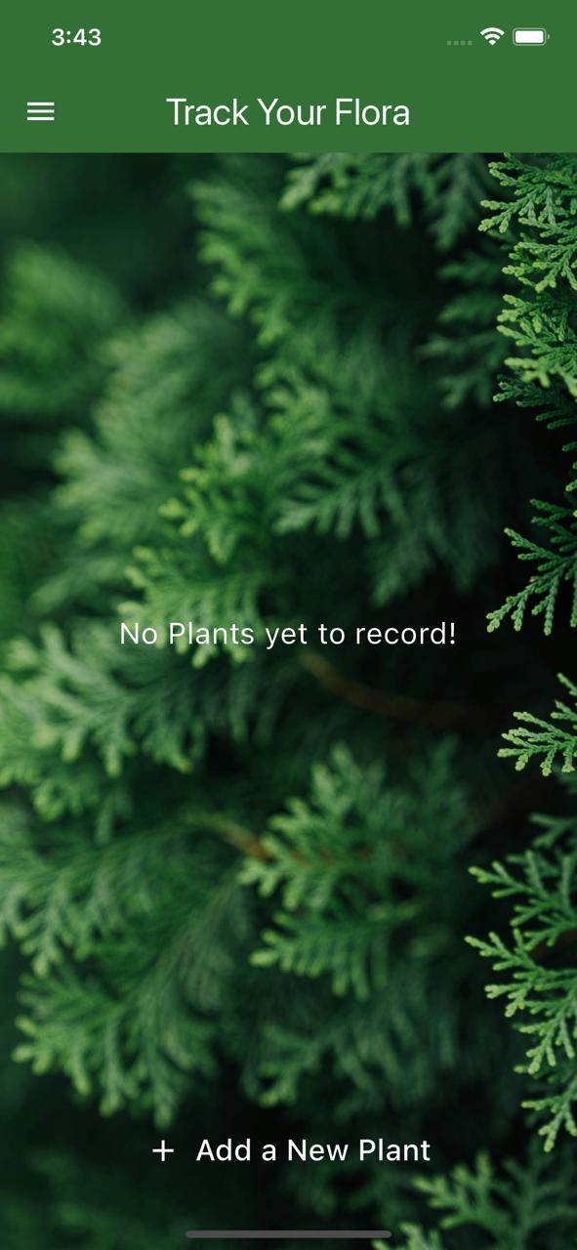
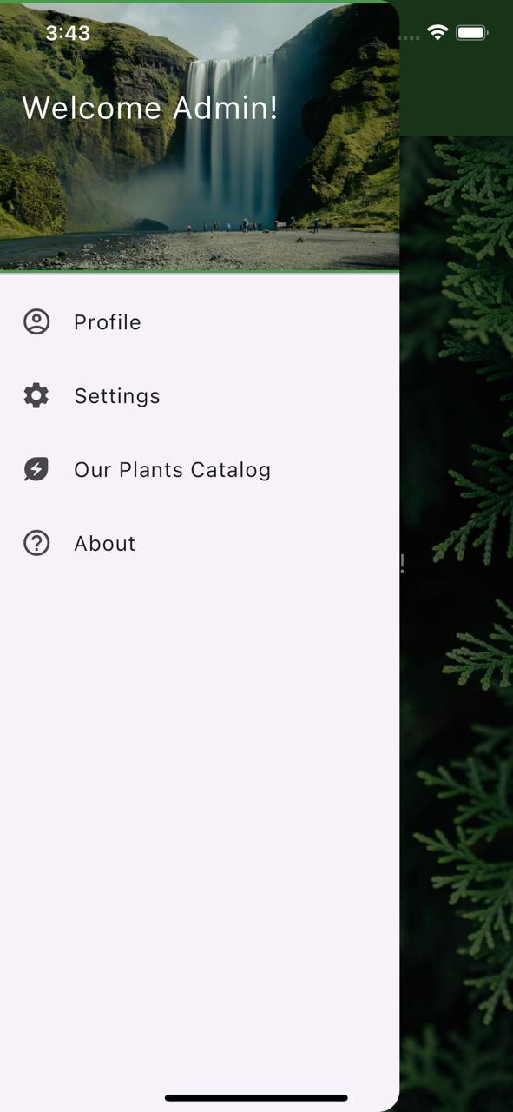

Slide 7
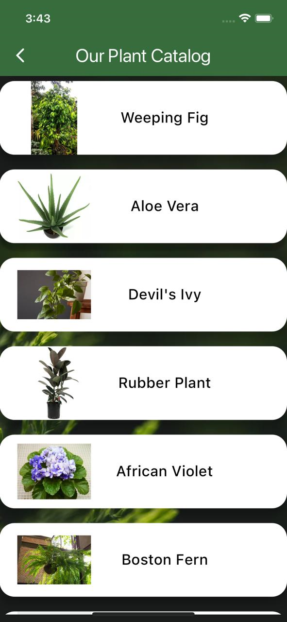
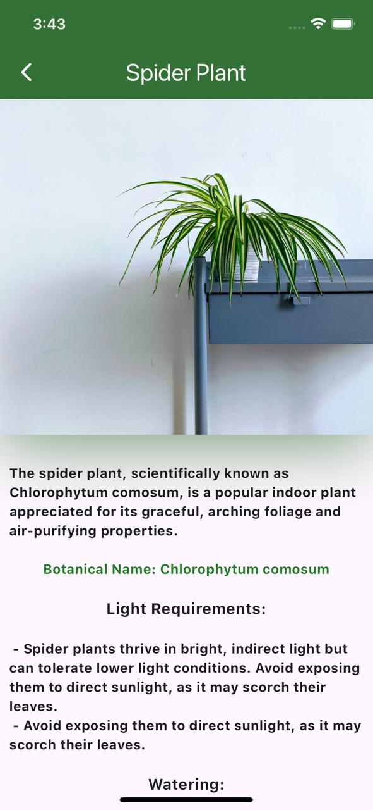
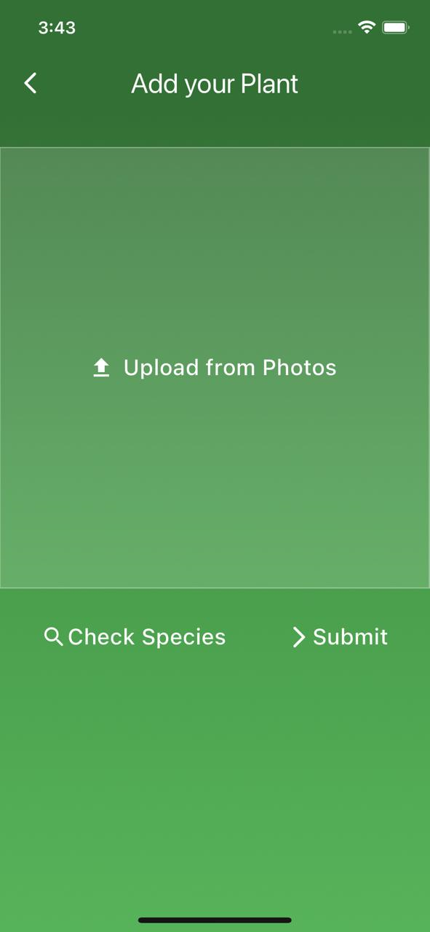

Slide 8
Process Flow

Slide 9
Algorithm
User Clicks a photo/ Uploads a photo from their phone’s gallery to the application
This image is then fed to the Image Classifier built for this application
Based on the classifier’s output, the plant is recognized
The Information Card of this plant species is then displayed in our application
And a record of the plant is made, thus previous plants are also visible

Slide 10
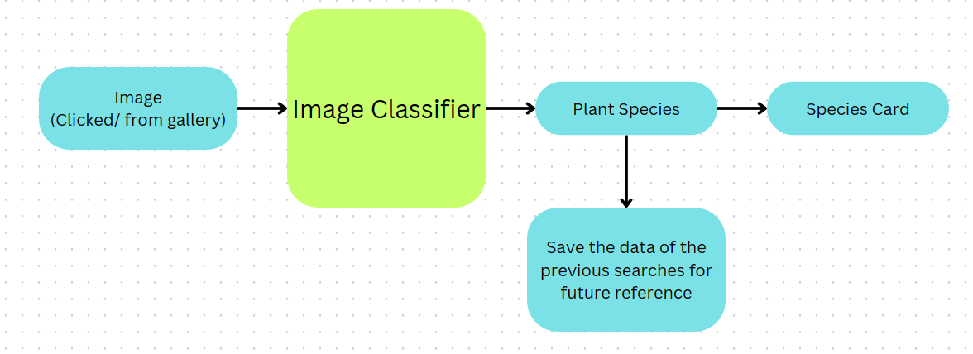

Slide 11
Python Libraries Used

Slide 12
selenium
Automated Web Testing
Cross-Browser Compatibility
WebDriver API
Integration with Testing Frameworks
In our project we have made use of selenium to extract images of plants of each species to create the dataset to train the model
This was possible using selenium Automated Web Testing feature which allows us to download the images we see on the web page of the web-browser.

Slide 13
Flask
Flask is a lightweight web application framework written in Python
It is designed to be simple, flexible, and easy to use, making it ideal for developing web applications and APIs
Flask provides a URL building feature that generates URLs for endpoints based on their names and arguments
This featured is employed to feed images to the API endpoint
From the same endpoint, the Image Classifier model accepts in images for identification
The result of the AI model is given to a text file
Flutter’s built-in file handling is used finally to read in from the text file and create a Plant Card for the same

Slide 14
TensorFlow and Keras
TensorFlow is an open-source machine learning framework developed by Google Brain Team
It allows for fast experimentation and prototyping of neural network architectures due to its user-friendly interface
TensorFlow allows you to define, train, and deploy deep learning models efficiently across various platforms and devices
Keras provides a consistent and simple API for defining and training various types of neural networks, including convolutional neural networks (CNNs), recurrent neural networks (RNNs), and more
It supports both TensorFlow, Theano, and Microsoft Cognitive Toolkit (CNTK) as backend engines, allowing flexibility in choosing the underlying computation framework
Keras emphasizes modularity and extensibility, enabling users to easily create and combine different layers and modules to build complex neural network architectures
Keras has been integrated into TensorFlow as its official high-level API since TensorFlow 2.0, making it the recommended interface for building neural networks within the TensorFlow ecosystem

Slide 15
Limitations

Slide 16
Limitations
Only identify ten species
Image classifier model is overfitting
Individual plant tracking not available
Disease identification not available
Limited database generated

Slide 17
Future Expansion

Slide 18
Our Upscaling Ideas
Improved Dataset
Improved Model
User profiles
Plant Personalization Functionality
Disease Identification through symptoms and image
Disease Tracking post indentification

Slide 19

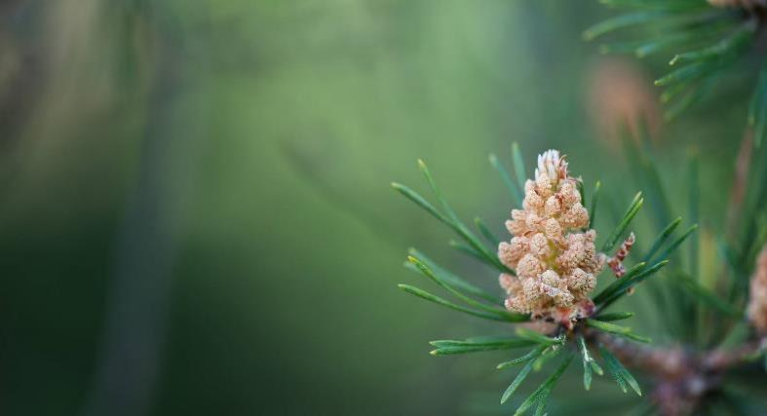
Summary
This project has been an enriching experience for us: where we explored in depth the intricacies of programming in python; we studied and implemented different technologies regarding front-end, back-end and machine learning algorithms; and has opened an avenue of project-based problem solving.

Slide 20
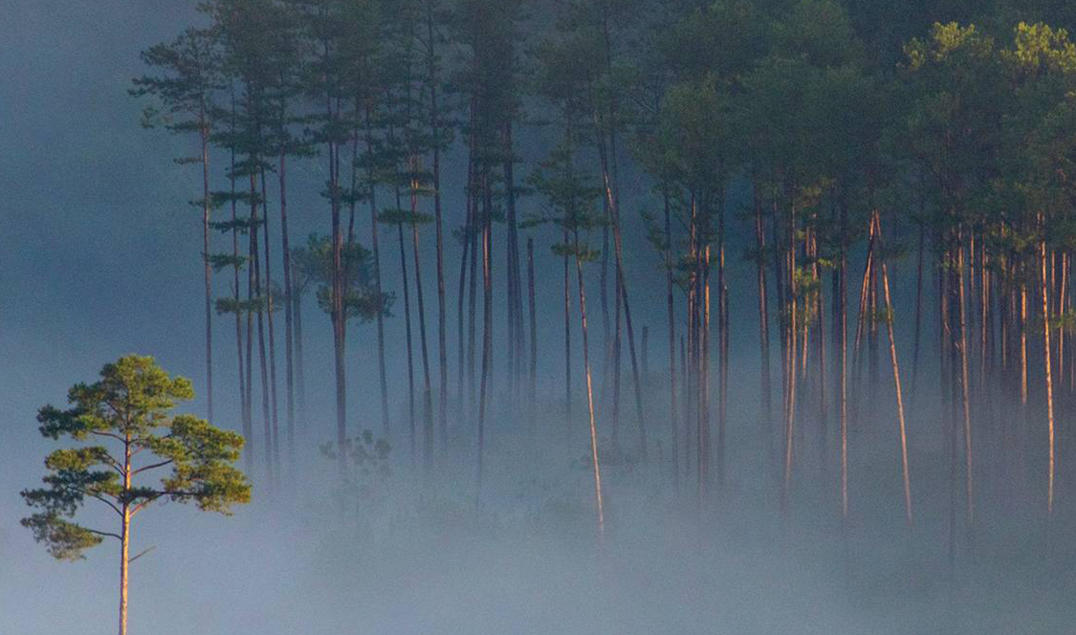
Thank you
Chinmay Mulmule (612203120)
Atharv Munot (612203121)

